Slide 1
Applets and Threading

Slide 2


Introduction
An applet is a Java program that runs in a web browser and is embedded in an HTML page.
It is designed for dynamic and interactive content in webpages.
Unlike standalone Java applications, applets do not have a main() method and are controlled by the browser or applet viewer.
An applet is a Java class that extends the java.applet.Applet class.
When a user views an HTML page that contains an applet, the code for the applet is downloaded to the user's machine.
A JVM is required to view an applet. The JVM can be either a plug-in of the Web browser or a separate runtime environment.

Slide 3








Java Application vs Applet
Feature | Java Application | Java Applet
Execution | Runs with main() method | Runs inside a web browser or applet viewer
Environment | Standalone program | Embedded in HTML or launched via viewer
Security | Has full access to system resources | Runs in a sandbox (limited permissions)
User Interface | Typically uses command-line or GUI | Must use AWT/Swing for UI
File Access | Can read/write files freely | Limited file access for security
Network Access | Full access | Can only connect to the host it was loaded from

Slide 4








Applet Life Cycle
Java Applets go through a well-defined life cycle, which is managed by the browser or applet viewer.
Life Cycle Methods:
init()
Called once when the applet is first loaded.
Used for initialization tasks and loading the resources.
start()
Called every time the applet becomes active or visible.
Used to start or resume operations like animations.
paint(Graphics g)
Called to draw the applet's output on the screen.
Automatically called after init() and start().
stop()
Called when the applet is no longer visible.
Used to suspend activities (like threads).
destroy()
Called when the applet is removed completely from memory.
Used for cleanup tasks.

Slide 5

Working with Applets
To create and use an applet in Java:
Extend the Applet class.
Override lifecycle methods: init(), start(), paint(), etc.
Compile the Java file.
Embed the applet in an HTML file using the <applet> tag or use an applet viewer.
import java.applet.Applet;
import java.awt.Graphics;
public class HelloApplet extends Applet {
public void paint(Graphics g) {
g.drawString("Hello, Applet!", 50, 50);
}
}

Slide 6

The HTML <APPLET> Tag
The <APPLET> tag is used in HTML to embed a Java applet:
  <applet code="HelloApplet.class" width="300" height="150">
  Your browser does not support Java applets.
  </applet>
Attributes:
code: Name of the .class file
width and height: Dimensions of the display area

Slide 7

java.applet Package
The java.applet package contains classes necessary for creating applets.
Key Classes:
Applet: The main class used to create applets; contains the lifecycle methods.
Method | Description
init() | Initialization logic
start() | Resume execution
stop() | Pause execution
destroy() | Cleanup before applet unloads
getParameter() | Reads parameters from the HTML <param> tag
showStatus() | Displays messages in the browser’s status bar

Slide 8








Drawing and Graphics in Applets
The paint(Graphics g) method allows drawing on the applet window. You can use it to render text, shapes, and images.
Common Graphics Methods:
Method | Description
drawString(String, x, y) | Draws text
drawLine(x1, y1, x2, y2) | Draws a line
drawRect(x, y, w, h) | Draws a rectangle
drawOval(x, y, w, h) | Draws an oval
setColor(Color c) | Sets the drawing color
setFont(Font f) | Sets the font for text

Slide 9






Example
import java.applet.Applet;
import java.awt.*;
/*
<applet code="SimpleGraphicsApplet.class" width="300" height="200">
</applet>
*/
public class SimpleGraphicsApplet extends Applet {
public void paint(Graphics g) {
g.setColor(Color.BLUE);
g.drawString("Welcome to Java Applets!", 50, 30);
g.drawRect(40, 50, 100, 50);
g.setColor(Color.RED);
g.fillOval(160, 50, 50, 50);
}
}
How to Run:
Save the code in a file named SimpleGraphicsApplet.java.
Compile: javac SimpleGraphicsApplet.java
Create an HTML file with the <applet> tag.
Open it with appletviewer:
Note: Modern IDEs and browsers may not support applets. Use older JDKs or command-line tools like appletviewer for testing.

Slide 10
Advantages of Applets
  Platform Independent: Applets are written in Java, so they can run on any platform with a Java-enabled browser.
  Web Integration: Applets can be embedded directly into web pages for interactive content.
  Security: Applets run in a restricted environment called a sandbox which prevents unauthorized access to system resources.
  No Installation Required: Users don't have to install anything extra—just load the webpage containing the applet.
Disadvantages of Applets
  Browser Support: Modern browsers no longer support Java applets due to security concerns.
  Performance: Applets may be slower to load, especially over slow networks.
  Security Restrictions: The sandbox restricts file I/O, system access, etc., which limits what an applet can do.
  Obsolete Technology: Java applets are largely outdated and replaced by more modern web technologies (e.g., JavaScript, HTML5, etc.).

Slide 11


Alternatives to Applets Today
Since applets are deprecated, developers now use:
  Java Web Start (also deprecated)
  JavaFX for rich desktop applications
  JavaScript/HTML5 for web interactivity
  Swing or JavaFX for GUI-based Java applications

Slide 12
Threading
Thread: A lightweight subprocess; the smallest unit of execution.
Threading refers to the ability of a program to perform multiple tasks simultaneously by dividing the execution into multiple threads. Each thread is an independent path of execution.
Multithreading: A programming feature that allows concurrent execution of two or more threads.
Concurrency: Performing multiple tasks at once.
Parallelism: Executing multiple threads at the same exact time (e.g., on multi-core processors).
Java provides built-in support for multithreading, enabling concurrent execution of two or more parts of a program for maximum utilization of CPU.

Slide 13





Creating Threads in Java
There are two main ways to create threads in Java:
Method 1: By Extending the Thread class
class MyThread extends Thread {
public void run() {
System.out.println("Thread is running...");
}
public static void main(String[] args) {
MyThread t1 = new MyThread();
t1.start(); // starts the thread and calls run()
}
}

Slide 14
Creating Threads in Java
Method 2: By Implementing the Runnable Interface
class MyRunnable implements Runnable {
public void run() {
System.out.println("Runnable thread running...");
}
public static void main(String[] args) {
MyRunnable obj = new MyRunnable();
Thread t1 = new Thread(obj);
t1.start();
}
}

Slide 15










Comparison:
Feature | Extending Thread | Implementing Runnable
Inheritance | Cannot extend another class | Can extend any class
Flexibility | Less flexible | More flexible
Best Practice | For simple use | Recommended approach

Slide 16

















Thread Life-Cycle in Java
A thread in Java goes through the following life-cycle stages:
1. New
A thread is created using new Thread() but has not started yet.
2. Runnable
After calling start(), the thread is ready to run and is placed in the runnable pool.
3. Running
When the thread is picked by the thread scheduler, it enters the running state and executes the run() method.
4. Blocked/Waiting/Sleeping
A thread can temporarily stop executing and enter a non-runnable state due to:
  Sleeping (Thread.sleep(ms))
  Waiting (wait())
  Blocked on I/O or resource
5. Terminated (Dead)
The thread completes its execution or is terminated manually.

Slide 17
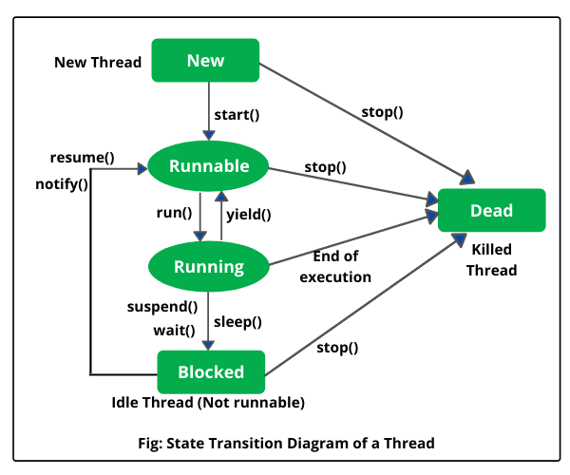





Thread Life-Cycle Diagram

Slide 18














Common Thread Methods
Method | Description
start() | Starts the thread and invokes run()
run() | Entry point of the thread
sleep(ms) | Pauses thread for the specified milliseconds
join() | Waits for a thread to die
isAlive() | Checks if thread is alive
setPriority(n) | Sets the thread priority (1 to 10)
yield() | Pauses current thread and allows others to execute

Slide 19







Example: Multi-threaded Program
class PrintTask extends Thread {
public void run() {
for (int i = 1; i <= 5; i++) {
System.out.println(getName() + " prints: " + i);
try {
Thread.sleep(3000);
} catch (InterruptedException e) {
System.out.println("Interrupted");
}
}
}
public static void main(String[] args) {
PrintTask t1 = new PrintTask();
PrintTask t2 = new PrintTask();
t1.start();
t2.start();
}
}
Output:
Thread-0 prints: 1
Thread-1 prints: 1
Thread-0 prints: 2
Thread-1 prints: 2
Thread-0 prints: 3
Thread-1 prints: 3
Thread-0 prints: 4
Thread-1 prints: 4
Thread-0 prints: 5
Thread-1 prints: 5

Slide 20





Thread Priorities
  Java threads have priorities from 1 (MIN_PRIORITY) to 10 (MAX_PRIORITY).
  The default priority is 5 (NORM_PRIORITY).
  Higher-priority threads may get more CPU time but priority is not guaranteed (depends on OS and scheduler).

